Slide 1
Building Single Page Applications
By Rohit Ghatol
(Director of Engineering @ Synerzip)
@TechNext on 21st July 2012

Slide 2
Topics
Understanding Single Page Application
Pros and Cons
Typical Architecture
Different Aspects of Single Page Applications
What Frameworks fit where?
Development Life Cycle
Future Developments to Watch out for

Slide 3
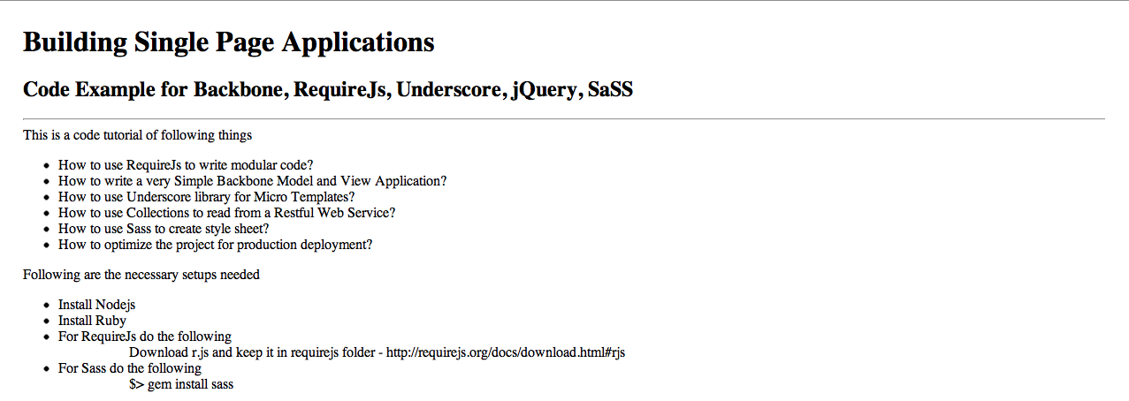
http://rohitghatol.github.com/SinglePageApplication/

Slide 4
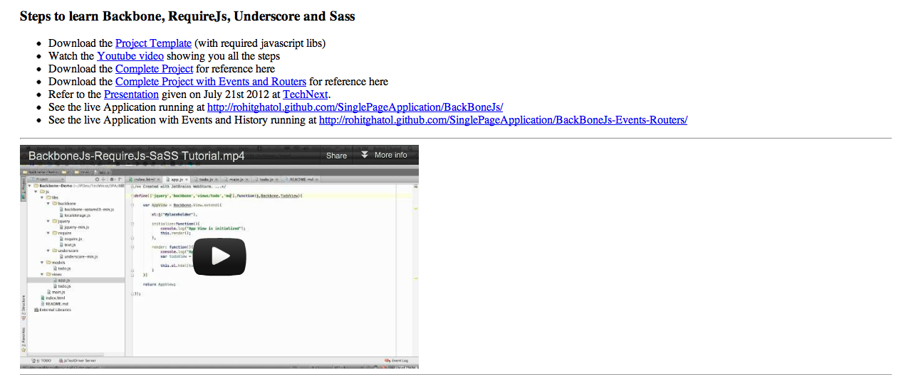
http://rohitghatol.github.com/SinglePageApplication/

Slide 5
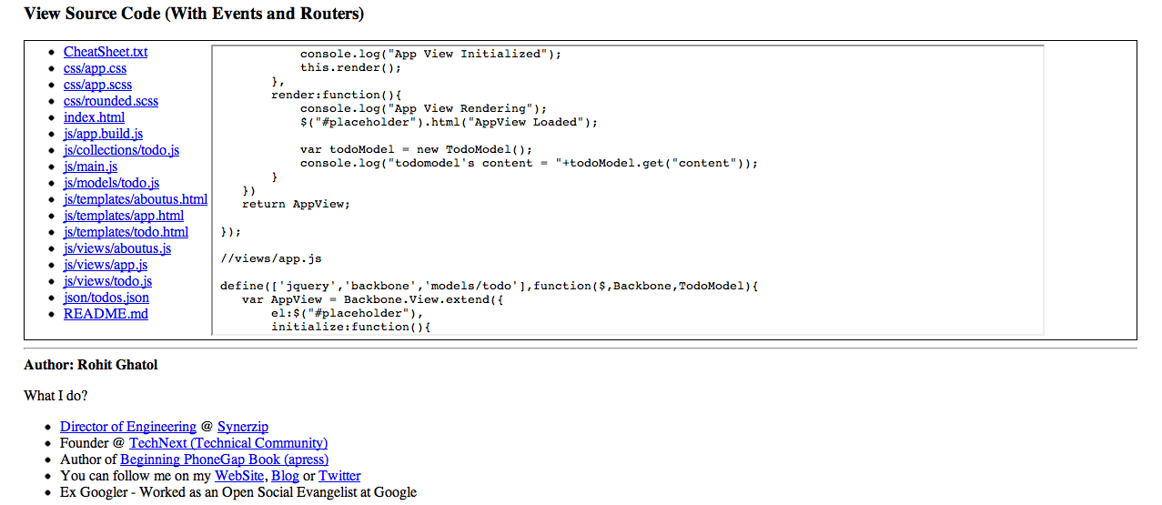
http://rohitghatol.github.com/SinglePageApplication/

Slide 6
What are “Single Page Applications”?

Slide 7
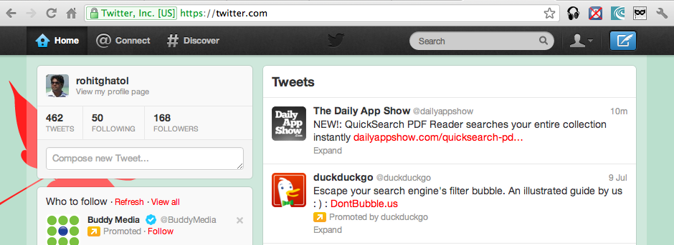
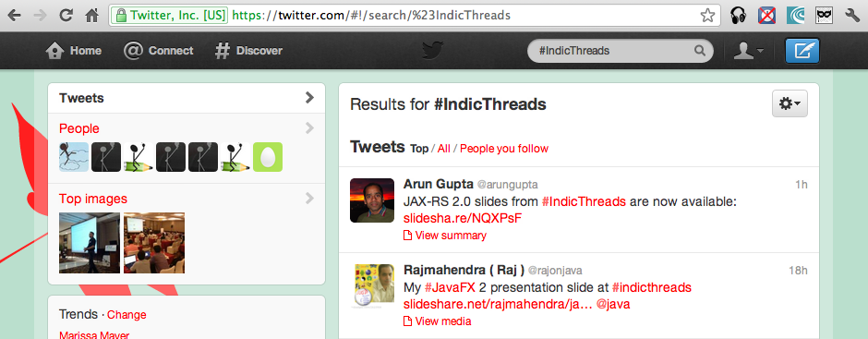

Slide 8
Characteristics of Single Page Application

Slide 9
Characteristics
No Url Change other than #
Back Button works as expected
Book mark able Links
Richer Interaction between UI Components
Ability to go Offline
Single Page is loaded, All UI built by JavaScript
Works with Restful Web Services
More such things…..

Slide 10
Pros and Cons

Slide 11
Pros and Cons
Faster UI
More Interactive
Can be made Offline
UI is just another Client
UI can have BI
Perfect for HTML 5 Mobile apps
Bad for SEO
More Complex to built
Need JavaScript Skills
Diff to choose JS lib
Post Dev Optimization learning curve is involved

Slide 12
Typical Architecture

Slide 13
Typical Architecture
Single Page Applications
Models
Views
Routers
Class
Controller
Templates
AMD
Presenter
DOM APIs
Declarative UI
View Model
Datastore
Local Storage
Web Sockets
Login APIs
CRUD APIs
Analytics
Notification
Restful Web Services
Server

Slide 14
Different Aspects of SPA

Slide 15
JavaScript framework Category
MVC
MVP
MVVM
HTML 5
AMD
Data Bound Views
Micro Template
Routers & History
CSS Optimization
Declarative UI
Class System
Production Packaging
DOM Manipulation
Mobile Apps

Slide 16
Class System

Slide 17
Test your JavaScript Skills
function foo(){
bar = “hello”;
}
foo();
alert(bar);
Hello
Any things without an var is a global variable.

Slide 18
Key thing about JavaScript
JavaScript is an Object Oriented Language!
But JavaScript does not have any classes!

Slide 19
Defining Classes

Slide 20
Function Approach
function Animal(){
this.name="cat";
this.getInfo = function(){
return this.name;
}
}
var anim = new Animal();
alert(anim.name);
alert(anim.getInfo());
cat
cat

Slide 21
Prototype Approach
function Animal(){
this.name="cat";
}
Animal.prototype.getInfo = function(){
return this.name;
}
var anim = new Animal();
alert(anim.name);
alert(anim.getInfo());
cat
cat

Slide 22
Closure Approach
function Animal(){
var name="cat";
this.getInfo = function(){
return name;
}
}
var anim = new Animal();
alert(anim.name);
alert(anim.getInfo());
Private ☺
undefined
cat

Slide 23
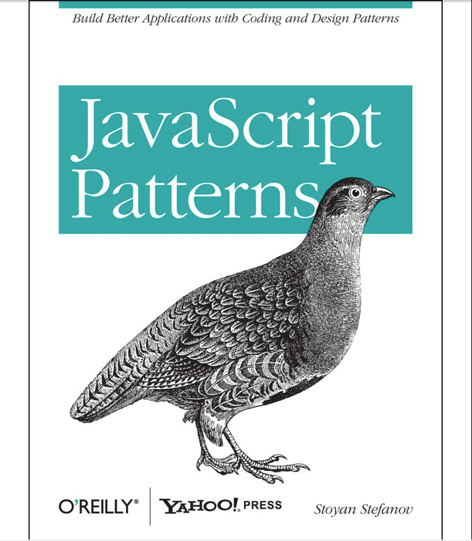
The JavaScript book I like ☺ !

Slide 24
Class Systems
Framework define their own Class Systems
Own ways of
Inheritance
Abstractions
Lets see some examples! ☺

Slide 25
Backbone Model Definition
Person = Backbone.Model.extend({
initialize: function(){
alert("Welcome to this world");
}
});
var person = new Person({ name: "Thomas", age: 67});

Slide 26
Sencha’s Class Definition
Ext.define('FirstApp.model.Place',{
extend:'Ext.data.Model',
config:{
fields:['id','recordId','name','icon','vicinity']
}
})

Slide 27
MVC
MVP
MVVM
Reference - http://joel.inpointform.net/software-development/mvvm-vs-mvp-vs-mvc-the-differences-explained/

Slide 28
Model View Controller
View
Passes Calls to
Controller
Fires Event
Model
Modifies

Slide 29
Model View Presenter
View
Passes Calls to
Updates
Presenter
Fires Event
Model
Modifies

Slide 30
Model View ViewModel
View
Modifies
Fires Event
View Model
Fires Event
Modifies
Model

Slide 31
AMD
Asynchronous Module Definition

Slide 32
JavaScript Class Dependency
View
depends
App
depends
Controller
depends
Model
depends
Store
depends

Slide 33
Typical HTML file
<head>
<script src=“model.js” …></script>
<script src=“store.js” …></script>
<script src=“view.js” …></script>
<script src=“controller.js” …></script>
<script src=“app.js” …></script>
</head>

Slide 34
With AMD
<head>
<script src=“require.js” type=“…”
data-main=“app.js”></script>
</head>

Slide 35
JavaScript Class Dependency
View
depends
App
depends
Controller
depends
Model
depends
Store
depends

Slide 36
Define Module
//Model.js
define(function(){
return {
"name":"Todo Model"
};
});

Slide 37
JavaScript Class Dependency
View
depends
App
depends
Controller
depends
Model
depends
Store
depends

Slide 38
Define Module
//Store.js
define([‘Model’],function(model){
return {
“create”:function(){..},
“retrieve”:function(){..},
“update”:function(){..},
“delete”:function(){..},
};
});

Slide 39
JavaScript Class Dependency
View
depends
App
depends
Controller
depends
Model
depends
Store
depends

Slide 40
Import Module
//View.js
define([’jQuery’,’Model’,’Store'],
function($,model, store){
store.update(model);
//render
$(“.view”).html(…);
return ..;
}) ;

Slide 41
JavaScript Class Dependency
View
depends
App
depends
Controller
depends
Model
depends
Store
depends

Slide 42
Import Module
//Controller.js
define([’jQuery’,’View’,’Store'],
function($,view, store){
view.setStore(store);
$(“#placeholder”).html(view.el());
return ..;
}) ;

Slide 43
JavaScript Class Dependency
View
depends
App
depends
Controller
depends
Model
depends
Store
depends

Slide 44
Import Module
//app.js
require([‘jQuery’,’Controller’],
function($,controller){
$(“#loading”).html(“”);
controller.initialize();
}) ;

Slide 45
History & Routers

Slide 46
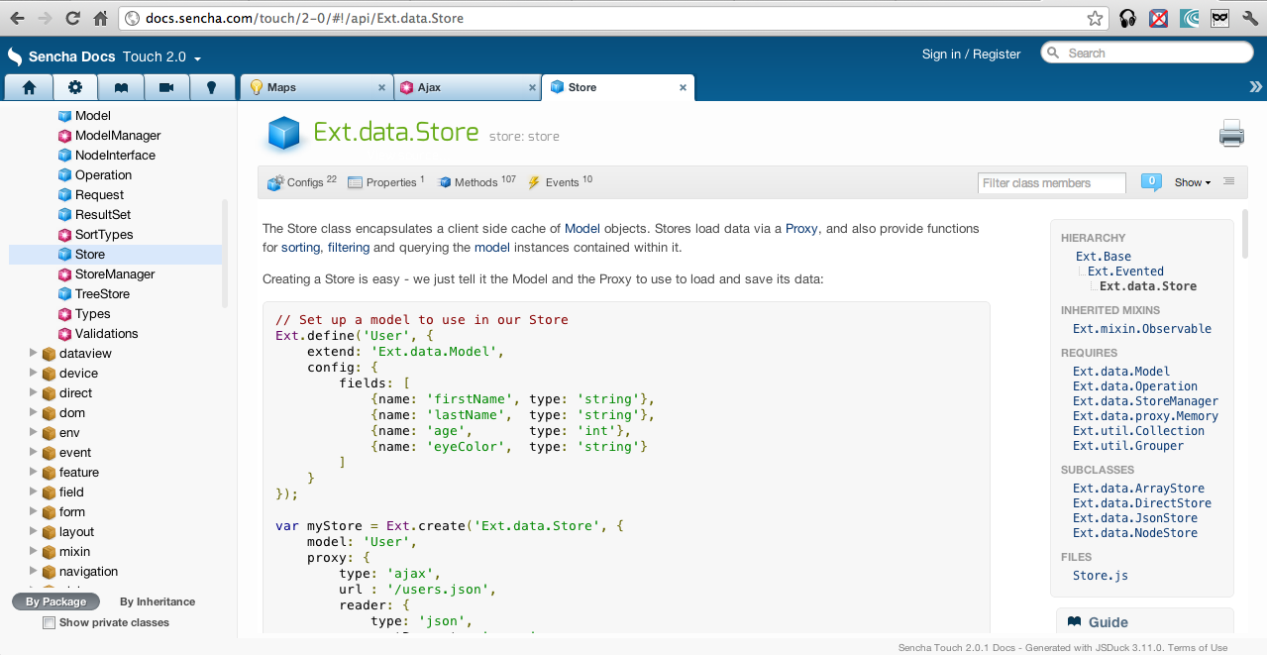
History

Slide 47

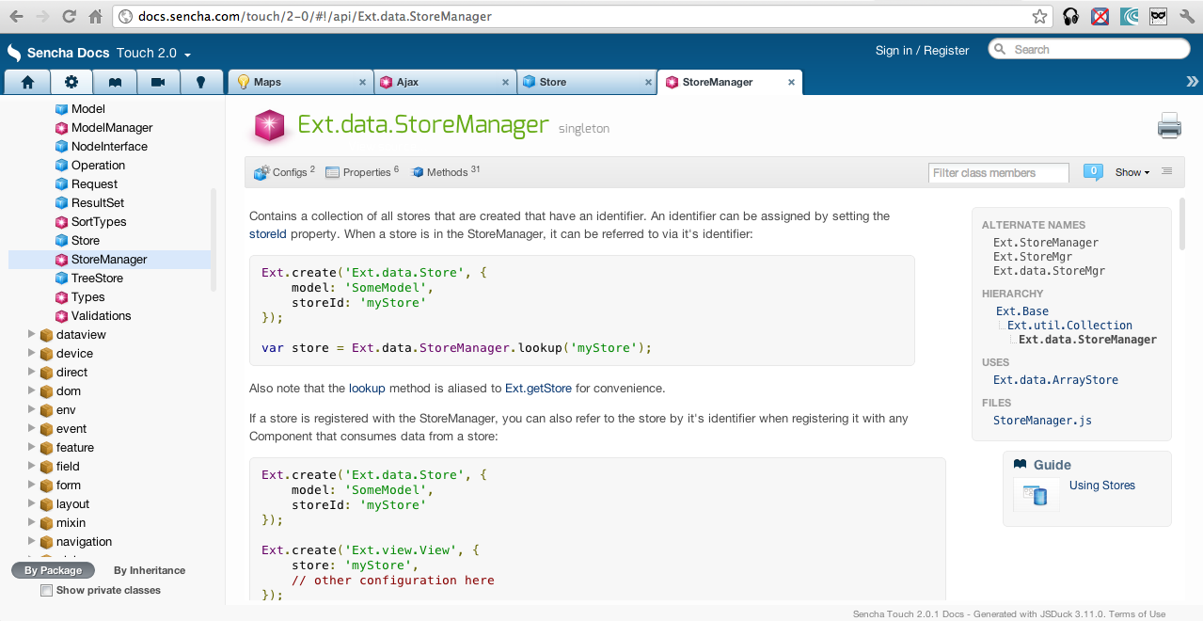
Routers
Router

Slide 48
Micro Template
Backbone Underscore Example

Slide 49
<div id="search_container"></div>
<script type="text/javascript">
SearchView = Backbone.View.extend({
initialize: function(){
this.render();
},
render: function(){
// jQuery to put in html snippet in DOM
$(this.el).html(“<label>Search</label><input type=“text” id=“…….”);
// Load the compiled HTML into the Backbone "el"
this.el.html( template );
}
});
var search_view = new SearchView({ el: $("#search_container") });
</script>

Slide 50
<div id="search_container"></div>
<script type="text/javascript">
SearchView = Backbone.View.extend({
initialize: function(){
this.render();
},
render: function(){
// Compile the template using underscore
var template = _.template( $("#search_template").html(), {} );
// Load the compiled HTML into the Backbone "el"
this.el.html( template );
}
});
var search_view = new SearchView({ el: $("#search_container") });
</script>
<script type="text/template" id="search_template">
<label>Search</label>
<input type="text" id="search_input" />
<input type="button" id="search_button" value="Search" />
</script>

Slide 51
<div id="search_container"></div>
<script type="text/javascript">
SearchView = Backbone.View.extend({
initialize: function(){
this.render();
},
render: function(){
var variables = { label: "My Search" };
// Compile the template using underscore
var template = _.template( $("#search_template").html(), {variables} );
// Load the compiled HTML into the Backbone "el"
this.el.html( template );
}
});
var search_view = new SearchView({ el: $("#search_container") });
</script>
<script type="text/template" id="search_template">
<label><%= label%></label>
<input type="text" id="search_input" />
<input type="button" id="search_button" value="Search" />
</script>

Slide 52
Data Bound Views

Slide 53
View
Store
Adapter
Source

Slide 54
Sencha Touch Example
DataStore can be populate from Rest, JSONP, LocalStorage
Proxy
Source
ListView
DataStore
Reader
Writer
Json or XML Readers and Writers
Model
e.g List or Grid with edit capabilities
Provides CRUD capabilities

Slide 55
Demo Time…..

Slide 56
DOM Manipulation

Slide 57
Key Points
jQuery is the biggest name
Zeptojs is an alternative
Xui is another alternative

Slide 58
HTML 5

Slide 59
Key Points
HTML 5 Features
Feature Detection and fall back
Polyfills
Helpful Sites
www.html5please.com
www.html5test.com

Slide 60
CSS 3 Optimization

Slide 61
Key Points
Sass - http://sass-lang.com/
Imports
Variables
Nested blocks
functions
Compass - http://compass-style.org/

Slide 62
Mobile Apps

Slide 63
Key Points
HTML 5 Hybrid Apps
PhoneGap
Trigger IO

Slide 64
Production Packaging

Slide 65
Key Points
Optimizing JavaScript and CSS resources
Minimizing, Concatenation, Obfuscation
Creation of Image Sprite
Example
RequireJS Optimizer
Sencha Touch SDK Tool
etc

Slide 66
Not Ready for JavaScript
Don’t have JavaScript skills
Skills not there
Willingness is not there
Enterprise world need proven technology
Want to reuse code client/server side
Need many of the feature discussed above in single package

Slide 67
Google Web Toolkit
Pros
Most Mature Single Page Application Framework
Code in Java, compiles to JavaScript
Commercial Widget Libraries available – Sencha EXT, Smart GWT available
Perfect for Enterprise

Slide 68
Google Web Toolkit
Cons
World will move to JavaScript sooner or later
Including third party JS libraries is possible but time consuming

Slide 69
Dart
See the video of Dart on Google IO 2012
Backed by Google
Runs on both Server and Browser
Still early!!

